Slide 1
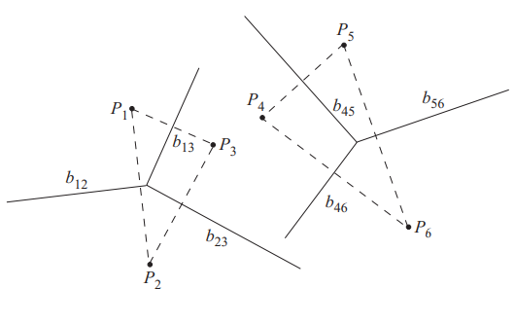
STEP1:
Find the convex hull of SL and SR
SR
SL

Slide 2
HP
STEP2:
Find the Perpendicular bisector of SG=P₁P₅
(Denote BS)
SR
SL

Slide 3
HP
STEP3:
HP = HP U BS
SR
SL

Slide 4
HP
STEP4:
Find the Perpendicular bisector of SG=P₁P₄
(Denote BS)
SR
SL

Slide 5
HP
STEP5:
HP = HP U BS
SR
SL

Slide 6
HP
STEP6:
Find the Perpendicular bisector of SG=P₃P₄
(Denote BS)
SR
SL

Slide 7
HP
STEP7:
HP = HP U BS
SR
SL

Slide 8
HP
STEP8:
Find the Perpendicular bisector of SG=P₃P₆
(Denote BS)
SR
SL

Slide 9
HP
STEP9:
HP = HP U BS
SR
SL

Slide 10
HP
STEP10:
Find the Perpendicular bisector of SG=P₂P₆
(Denote BS)
SR
SL

Slide 11
HP
STEP11:
HP = HP U BS
SR
SL

Slide 12
HP
STEP12:
Because, SG = P₂P₆
Discard edge of VD(S_{L}) extending to right
Discard edge of VD(S_{R}) extending to left
SR
SL

Slide 13
Merge Complete
SR
SL

